Slide 1


By Akkrapol Danklang

Slide 2

GraphQL คืออะไร
ภาษาคิวรีสำหรับ API: GraphQL เป็นภาษาคิวรีและระบบรันไทม์สำหรับ API ที่ช่วยให้ลูกค้าสามารถระบุข้อมูลที่ต้องการจาก API ได้อย่างแม่นยำ
พัฒนาโดย Facebook: ถูกพัฒนาโดย Facebook ในปี 2012 และเปิดเผยต่อสาธารณะในปี 2015
ปรับแต่งได้มาก: ให้ความยืดหยุ่นในการเข้าถึงข้อมูล โดยลูกค้าสามารถขอข้อมูลที่พวกเขาต้องการได้โดยตรง
?
ทำไมถึงต้องใช้ GraphQL?
เพื่อช่วยลดจำนวนคำขอและขนาดของคำขอไปยังเซิร์ฟเวอร์

Slide 3
RES API
Request
Client
Server
Response Fix Field
Json Format
GET
POST
PUT
PATCH
DELETE

Slide 4
GarphQL
Query
Request Field Dynamic
Client
GarphQL
Server
Response
Response Select Field

Slide 5
Json
Request
Response
{ "FirstName": "Fred", "Surname": "Smith", "Age": 28, "Address": { "Street": "Hursley Park", "City": "Winchester", "Postcode": "SO21 2JN" },
{ "Age": 28 ,
"Surname": "Smith" },

Slide 6
GraphQL
Request
Response
{
"data": {
"query": [
{
"id": "1",
"name": "member001",
}, ] }
{
query: getMember{
id
name
},
}
{
"data": {
"query": [
{
"name": "member001",
}, ] }
{
query: getMember{
name
},
}

Slide 7
CMD
สำหรับเริ่มเขียน GrapHQL ด้วย Go
go get github.com/gofiber/fiber/v2
go get github.com/99designs/gqlgen
go get github.com/99designs/gqlgen/internal/imports@v0.17.42
go get github.com/99designs/gqlgen/codegen@v0.17.42
go get github.com/99designs/gqlgen@v0.17.42
Knowledge : https://graphql.org/learn/schema/

Slide 8
Main.go
(Setup GQLGEN)
go run github.com/99designs/gqlgen init go get github.com/99designs/gqlgen/graphql/handler go get github.com/gofiber/fiber/v2 go get github.com/valyala/fasthttp/fasthttpadaptor
go get github.com/99designs/gqlgen
go get github.com/99designs/gqlgen/internal/imports@v0.17.42
go get github.com/99designs/gqlgen/codegen@v0.17.42
go get github.com/99designs/gqlgen@v0.17.42

Slide 9
Main.go
(Install Fiber)
func main() { app := fiber.New()
log.Fatal(app.Listen(":3000"))
}
app.Post("/query", func(c *fiber.Ctx) error {
h := http.HandlerFunc(func(w http.ResponseWriter, r *http.Request) {
srv.ServeHTTP(w, r)
})
fasthttpadaptor.NewFastHTTPHandlerFunc(h)(c.Context())
return nil
})

Slide 10
schema.graphqls
(Install Fiber)
type Member {
id: ID!
name: String!
position : PositionName!
worker : [List!]!
}
enum PositionName {
President
VicePresident
Treasurer
Secretary
}
type List {
name: String!
point : Int!
}
มีความหมายว่า Not Null

Slide 11
Main.go
(Create Model)
go get github.com/99designs/gqlgen/internal/imports@v0.17.42
go get github.com/99designs/gqlgen/codegen@v0.17.42
go get github.com/99designs/gqlgen@v0.17.42
go run github.com/99designs/gqlgen generate

Slide 12
Create
(Call Handler Mock Data)
Handlers/mockData.go
var member = []*model.Member{
{
ID: "1",
Name: "member001",
Position: model.AllPositionName[0],
Worker: []*model.List{
{
Name: "view",
Point: 10,
},
},
},
{
ID: "2",
Name: "member002",
Position: model.AllPositionName[1],
Worker: []*model.List{
{
Name: "edit",
Point: 5,
},
},
},
}

Slide 13
Create
(Install Fiber)
Handlers/getHandler.go
func GetMember() []*model.Member {
return member
}
schema.graphqls (Create QUERY HANDLER)
type Query {
getMember : [Member!]!
}

Slide 14
member.resolvers.go
(Create QUERY HANDLER)
panic(fmt.Errorf("not implemented: GetMember - getMember"))
return handlers.GetMember(), nil

Slide 15
schema.graphqls
(Create Model)
go get github.com/99designs/gqlgen/internal/imports@v0.17.42
go get github.com/99designs/gqlgen/codegen@v0.17.42
go get github.com/99designs/gqlgen@v0.17.42
go run github.com/99designs/gqlgen generate

Slide 16
POSTMAN
Request
(QUERY)
Response
{
"data": {
"query": [
{
"id": "1",
"name": "member001",
"position": "President",
"worker": [
{
"name": "view",
"point": 10
}
]
},
{
"id": "2",
"name": "member002",
"position": "VicePresident",
"worker": [
{
"name": "edit",
"point": 5
}
]
}
]
}
}
{
query: getMember{
id
name
position
worker {
name
point
}
}
}

Slide 17
Create
(FIND Data)
Handlers/findHandler.go
func FindMemberByID(id int) (*model.Member, error) {
strID := strconv.Itoa(id)
for _, m := range member {
if m.ID == strID {
return m, nil
}
}
return nil, fmt.Errorf("member with ID %d not found", id)
}
schema.graphqls (Create QUERY HANDLER)
type Query {
findMember(id: Int!): Member
}

Slide 18
schema.graphqls
(GENERATE MODEL)
go get github.com/99designs/gqlgen/internal/imports@v0.17.42
go get github.com/99designs/gqlgen/codegen@v0.17.42
go get github.com/99designs/gqlgen@v0.17.42
go run github.com/99designs/gqlgen generate

Slide 19
member.resolvers.go
(Create QUERY HANDLER)
func (r *queryResolver) FindMember(ctx context.Context, id int) (*model.Member, error) {
member, err := handlers.FindMemberByID(id)
if err != nil {
log.Printf("Error finding member: %v", err)
return nil, err
}
return member, nil
}

Slide 20
POSTMAN
Request
(QUERY)
Response
{
"data": {
"findMember": {
"id": "2",
"name": "member002",
"position": "VicePresident"
}
}
}
{
findMember(id: 2) {
id
name
position
}
}

Slide 21
Mutations (การจัดการข้อมูลใน GarphQL)
Knowledge : https://graphql.org/learn/schema/

Slide 22
Create
(ADD Data)
Handlers/addHandler.go
func AddMember(newMember *model.Member) {
member = append(member, newMember)
}
schema.graphqls (Create QUERY HANDLER)
type Mutation {
addMember(id: Int!, name: String!, position: String!): Member
}

Slide 23
schema.graphqls
(GENERATE MODEL)
go get github.com/99designs/gqlgen/internal/imports@v0.17.42
go get github.com/99designs/gqlgen/codegen@v0.17.42
go get github.com/99designs/gqlgen@v0.17.42
go run github.com/99designs/gqlgen generate

Slide 24
member.resolvers.go
(Create QUERY HANDLER)
func (r *mutationResolver) AddMember(ctx context.Context, id int, name string, position string) (*model.Member, error) {
strID := strconv.Itoa(id)
newMember := &model.Member{
ID: strID,
Name: name,
Position: model.PositionName(position),
Worker: []*model.List{{Name: listName, Point: point}},
}
handlers.AddMember(newMember)
return newMember, nil
}

Slide 25
POSTMAN
Request
(QUERY)
Response
{
"data": {
"addMember": {
"id": "3",
"name": "member003",
"position": "Developer",
"worker": [
{
"name": "todo",
"point": 50
}
]
}
}
}
mutation {
addMember(id: 3, name: "member003", position: "Developer", listName: "todo", point: 50) {
id
name
position
worker{
name
point
},
}
}

Slide 26
Create
(EDIT Data)
Handlers/editHandler.go
func EditMember(id int, newName string, newPosition model.PositionName, listName string, point int) error {
strID := strconv.Itoa(id)
for i, m := range member {
if m.ID == strID {
member[i].Name = newName
member[i].Position = newPosition
for j, worker := range member[i].Worker {
if worker.Name == listName {
member[i].Worker[j].Point = point
break
}
}
return nil
}
}
return fmt.Errorf("member with ID %d not found", id)
}
schema.graphqls (Create QUERY HANDLER)
type Mutation {
editMember(id: Int!, name: String!, position: String!, listName: String!, point: Int!): Member
}

Slide 27
schema.graphqls
(GENERATE MODEL)
go get github.com/99designs/gqlgen/internal/imports@v0.17.42
go get github.com/99designs/gqlgen/codegen@v0.17.42
go get github.com/99designs/gqlgen@v0.17.42
go run github.com/99designs/gqlgen generate

Slide 28
member.resolvers.go
(Create QUERY HANDLER)
func (r *mutationResolver) EditMember(ctx context.Context, id int, name string, position string, listName string, point int) (*model.Member, error) {
err := handlers.EditMember(id, name, model.PositionName(position), listName, point)
if err != nil {
return nil, err
}
return handlers.FindMemberByID(id)
}

Slide 29
POSTMAN
Request
(QUERY)
Response
{
"data": {
"editMember": {
"id": "3",
"name": "member003",
"position": "Goal",
"worker": [
{
"name": "todo",
"point": 80
}
]
}
}
}
mutation {
editMember(id: 3, name: "member003", position: "Goal", listName: "todo", point: 80) {
id
name
position
worker{
name
point
},
}
}

Slide 30
Create
(FIND Data)
Handlers/findHandler.go
func DeleteMember(id int) error {
strID := strconv.Itoa(id)
for i, m := range member {
if m.ID == strID {
member = append(member[:i], member[i+1:]...)
return nil
}
}
return fmt.Errorf("member with ID %d not found", id)
}
schema.graphqls (Create QUERY HANDLER)
type Mutation {
deleteMember(id: Int!): Boolean! }

Slide 31
schema.graphqls
(GENERATE MODEL)
go get github.com/99designs/gqlgen/internal/imports@v0.17.42
go get github.com/99designs/gqlgen/codegen@v0.17.42
go get github.com/99designs/gqlgen@v0.17.42
go run github.com/99designs/gqlgen generate

Slide 32
member.resolvers.go
(Create QUERY HANDLER)
func (r *mutationResolver) DeleteMember(ctx context.Context, id int) (bool, error) {
err := handlers.DeleteMember(id)
if err != nil {
return false, err
}
return true, nil
}

Slide 33
POSTMAN
Request
(QUERY)
Response
{
"data": {
" deleteMember": {
"id": "3",
"name": "member003",
"position": "Goal",
"worker": [
{
"name": "todo",
"point": 80
}
]
}
}
}
mutation {
deleteMember(id: 3) }

Slide 34
WEBHOOK คืออะไร
การคุยกันระหว่าง app 2 app

Slide 35
WEBHOOK
APP A
APP B
POST EVENT
TOKEN

Slide 36


WEBHOOK

Slide 37
setup : สำหรับเริ่มเขียน WEBHOOK ด้วย Go
go get github.com/gofiber/fiber/v2
https://discord.com

Slide 38
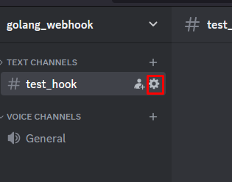
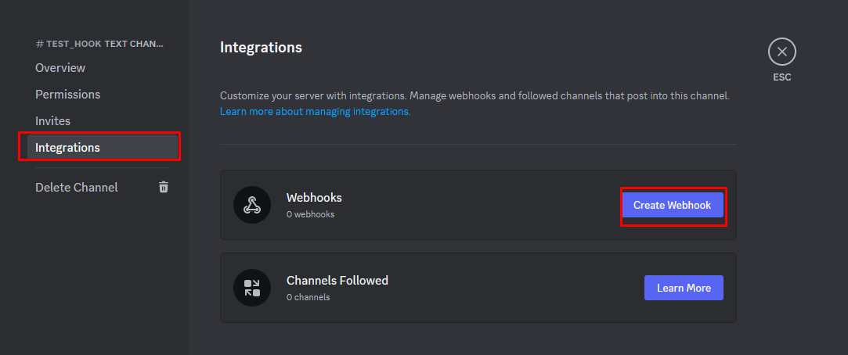
สร้าง URL สำหรับ webhook
1
2
3

Slide 39
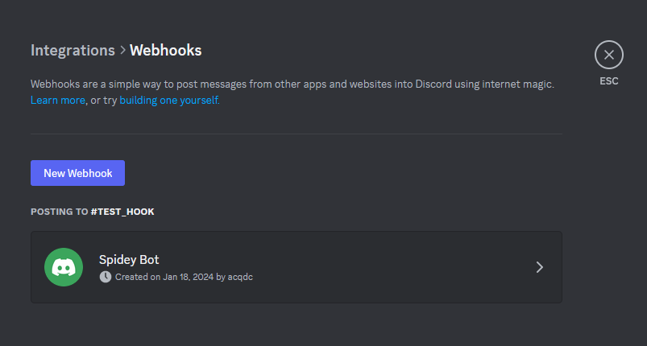
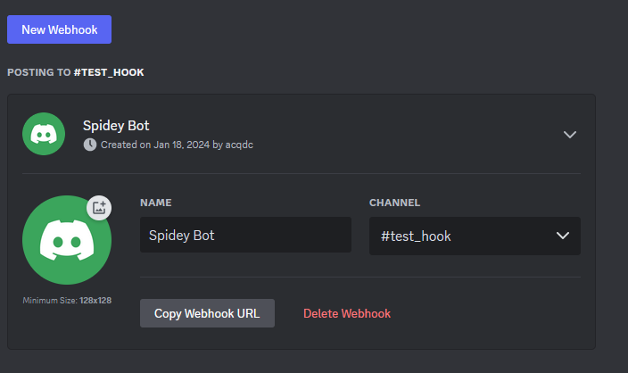
สร้าง URL สำหรับ webhook
1
2
url : https://discord.com/api/webhooks/1197243995814907955/j8-YZSE6FhDQwh92mS9P4S1M1Ssp7sQo4LPpkFN3vSaQAbtM5Vf6_uLCCqlUUBqR7paY

Slide 40
MAIN.go
const discordWebhookURL = "https://discord.com/api/webhooks/1197086686576906281/KWHJ7bPUOKzlDQgz9nkIR57XVx8SaytJ5EP7CeqUwhHA05uwatF5I1L-fp77fTdqyQ28"
type DiscordMessage struct {
Content string `json:"content"`
}
func main() {
app := fiber.New()
app.Post("/send-message", func(c *fiber.Ctx) error {
message := "Hello, Discord!"
err := sendDiscordMessage(message)
if err != nil {
return c.Status(500).SendString(err.Error())
}
return c.SendString("Message sent successfully!")
})
log.Fatal(app.Listen(":3000"))
}

Slide 41
MAIN.go
func sendDiscordMessage(message string) error {
webhookMessage := DiscordMessage{Content: message}
payload, err := json.Marshal(webhookMessage)
if err != nil {
return err
}
resp, err := http.Post(discordWebhookURL, "application/json", bytes.NewBuffer(payload))
if err != nil {
return err
}
defer resp.Body.Close()
if resp.StatusCode != http.StatusOK {
return fmt.Errorf("failed to send Discord message, status code: %d", resp.StatusCode)
}
return nil
}

Slide 42
DISCORD BOT
COMMAND
Response

Slide 43
setup : สำหรับเริ่มเขียน DISCORD BOT ด้วย Go
Go get github.com/bwmarrin/discordgo
https://discord.com/developers/applications

Slide 44
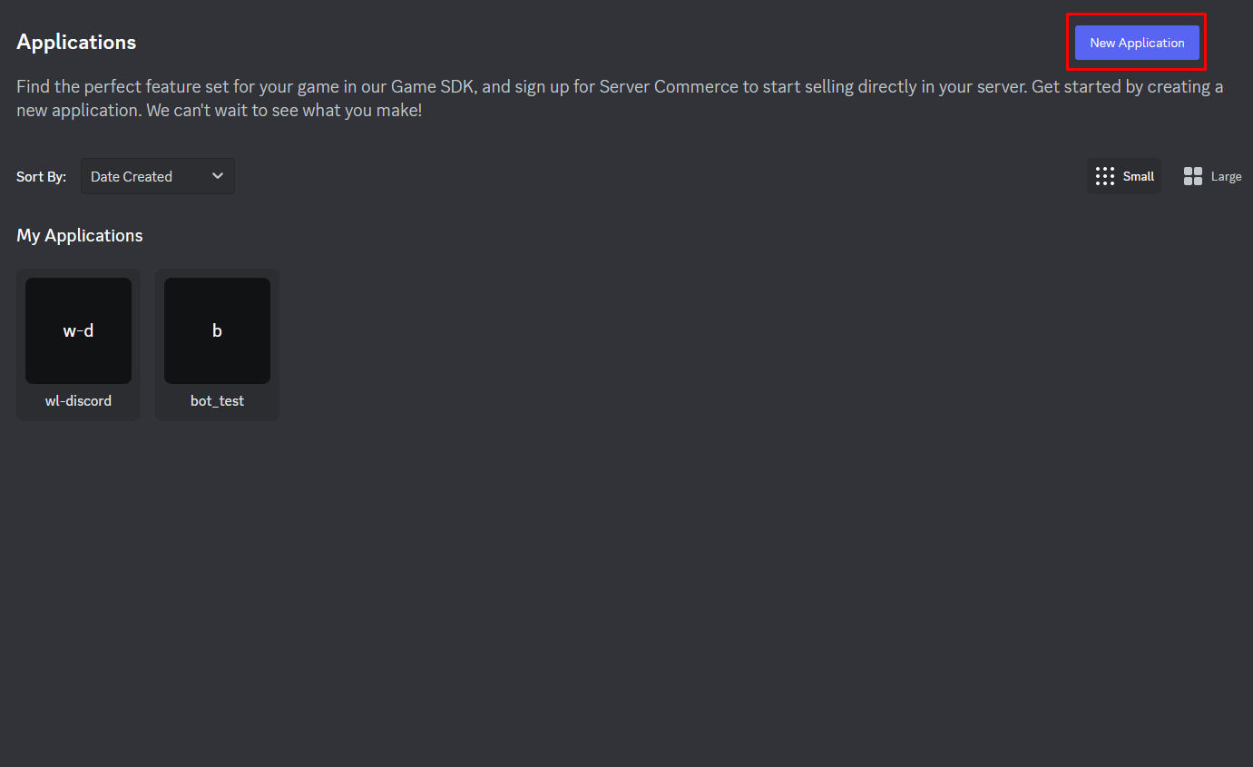
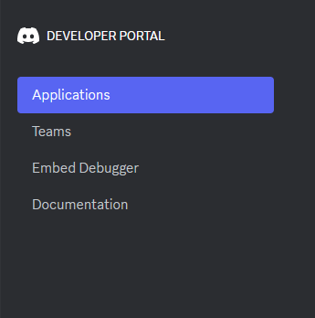
1.การขอ Token เพื่อนำไปเขียน bot
2
1

Slide 45
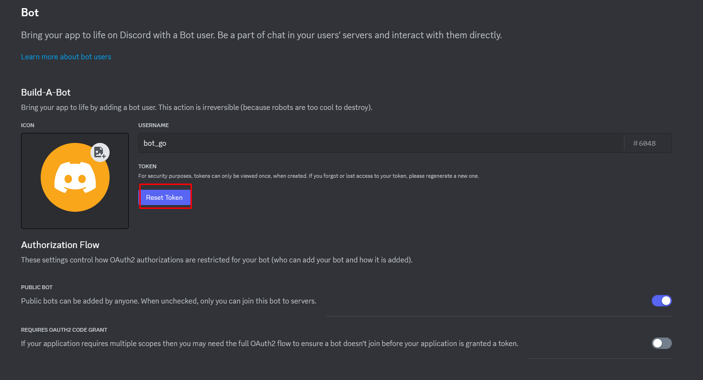
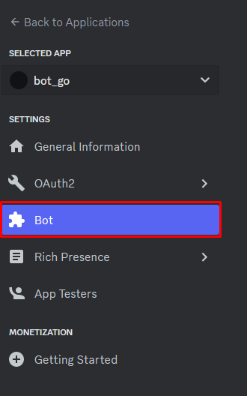
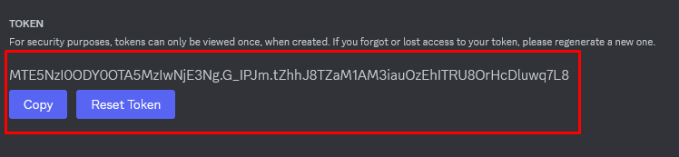
2.Reset Token เพื่อขอ Token
1
2
3

Slide 46
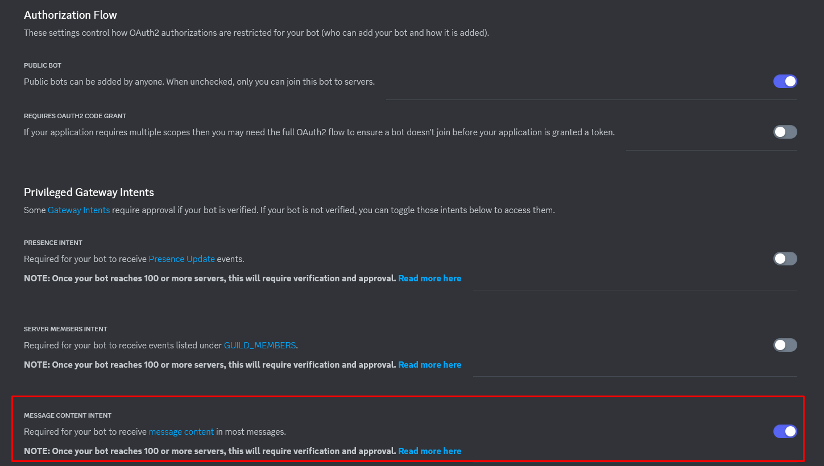
3.enable message content intent เพื่อขอ url

Slide 47
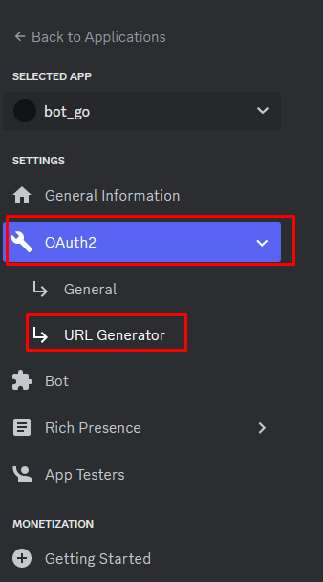
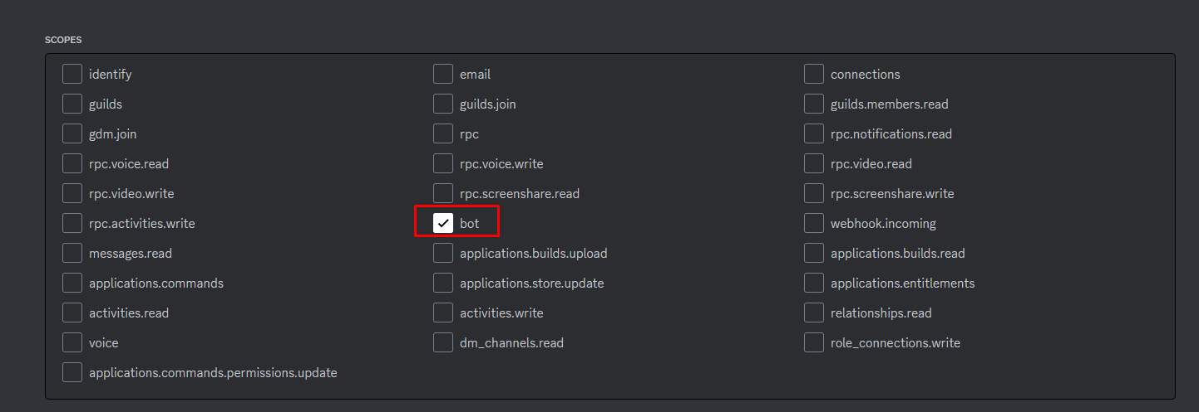
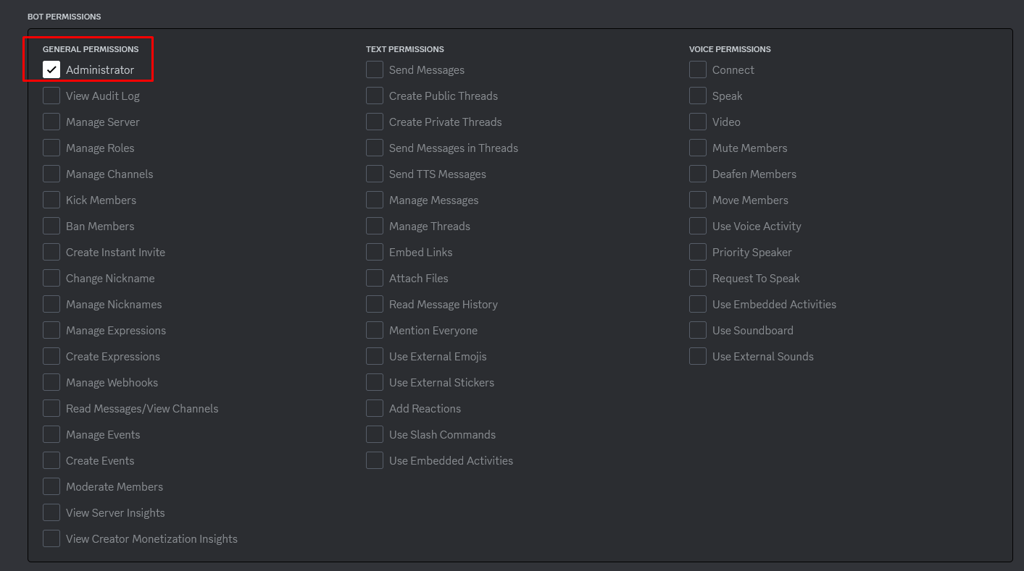
4.เปิดสิทธิ์ขอลิ้งในการสร้าง Bot
2
1
3

Slide 48
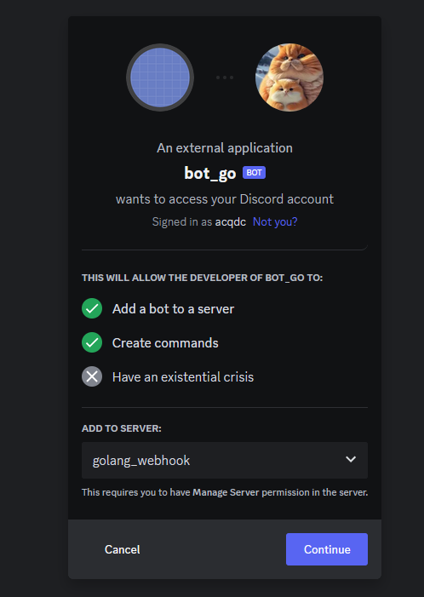
5.นำลิ้งเชื่อมยัง server ที่ดูแล
https://discord.com/api/oauth2/authorize?client_id=1197248649093206176&permissions=8&scope=bot

Slide 49
MAIN.go
func main() {
dg, err := discordgo.New("Bot MTE5NzI0ODY0OTA5MzIwNjE3Ng.GDUQNE.qknVEzYCrf2gbRePnwFA-AB9iSrHDJ3XXzULrE")
if err != nil {
fmt.Println("Error creating Discord session:", err)
return
}
dg.AddHandler(func(s *discordgo.Session, m *discordgo.MessageCreate) {
if m.Author.ID == s.State.User.ID {
return
}
if m.Content == "hello" {
s.ChannelMessageSend(m.ChannelID, "World!")
}
})

Slide 50
MAIN.go
dg.Identify.Intents = discordgo.IntentsAllWithoutPrivileged
// Open a connection to Discord
err = dg.Open()
if err != nil {
log.Fatal(err)
return
}
defer dg.Close()
fmt.Println("Bot is now running. Press Ctrl+C to exit.")
// Wait until a signal is received to gracefully exit the bot
sc := make(chan os.Signal, 1)
signal.Notify(sc, syscall.SIGINT, syscall.SIGTERM, os.Interrupt)
<-sc
}

Slide 51
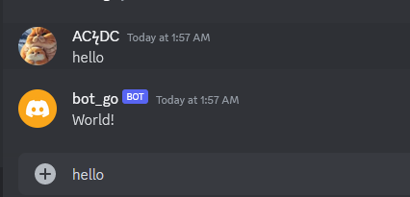
DISCORD BOT

